Slide 1
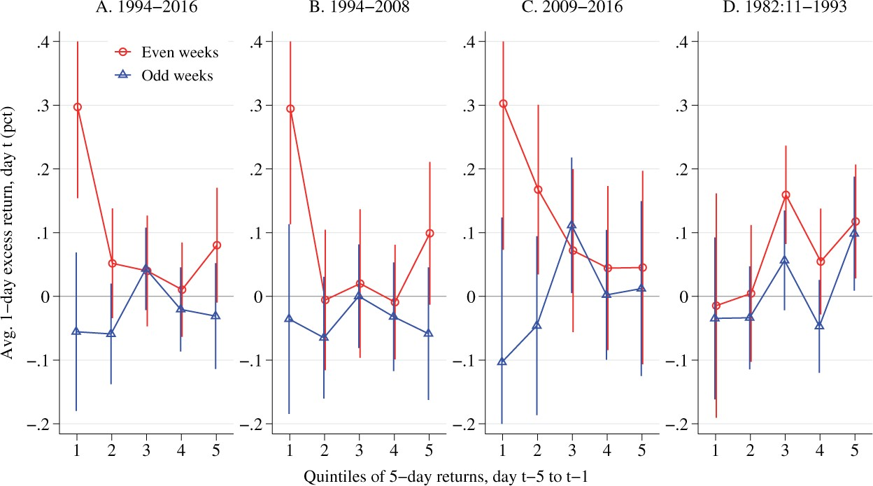

Figure 2 The Fed put in stock returns The figure reports the average daily excess stock returns by even- and ...
Notes:
Figure 2 The Fed put in stock returns The figure reports the average daily excess stock returns by even- and odd-numbered weeks of the FOMC cycle, conditional on returns realized over the previous week (by return quintiles, 1 = lowest; 5 = highest). Even and odd weeks are defined following CMVJ (2019). Return quintiles are defined over the 1994–2016 sample in panels A through C and over the 1982:11–1993 sample in panel D. Each plot contains 95% confidence intervals for the means. For readability of the graph, we truncate confidence intervals if they span outside of the $-$0.2% to 0.4% range.
Unless provided in the caption above, the following copyright applies to the content of this slide: © The Author(s) 2020. Published by Oxford University Press on behalf of The Society for Financial Studies. All rights reserved. For permissions, please e-mail: journals.permissions@oup.com.This article is published and distributed under the terms of the Oxford University Press, Standard Journals Publication Model (https://academic.oup.com/journals/pages/open_access/funder_policies/chorus/standard_publication_model)

